Slide 1
Machine learning 101 Introduction to machine learning
Han Xiao
CEE department

Slide 2
Welcome!
WHAT?
WHY?
HOW?
What could we do with ML?
What you gonna learn?

Slide 3
Before to the topic…
Prerequisites
-Basic knowledge of mathematics
-Know how to open your computer and type
Combination of theories and techniques
Talks by professors

Slide 4

What is machine learning?
Machine + Learning

Slide 5
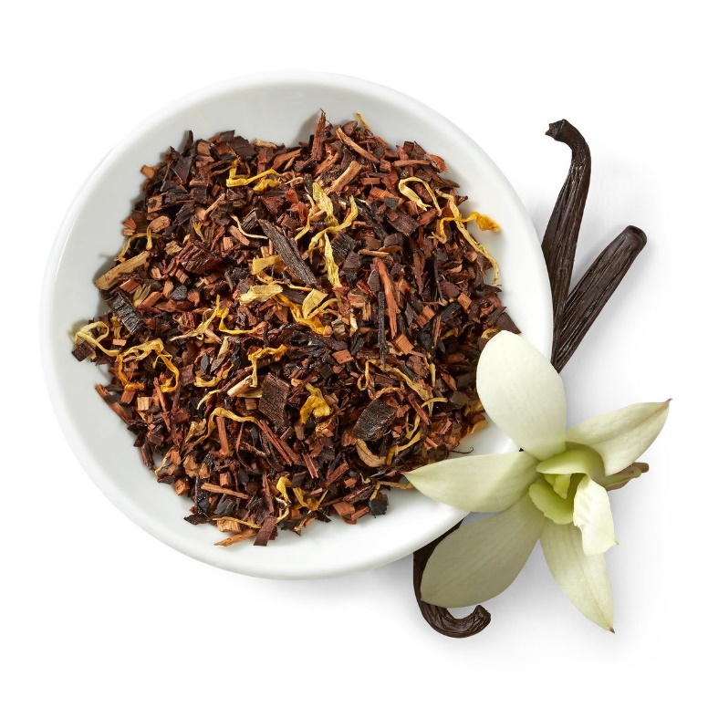
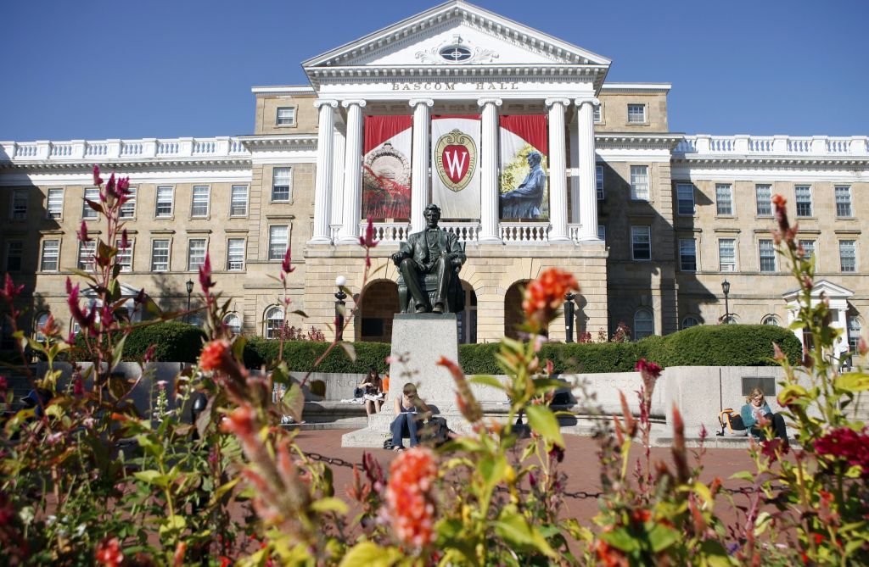


What is machine learning?
Learning

Slide 6
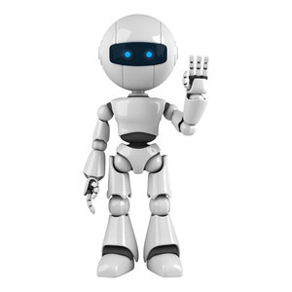
What is machine learning?
Learning
Observations → Brain → Skill
Machine learning
Data → --→Skill

Slide 7
What is machine learning?
Mathematically
Need: Training data, and what we want
(x,y) → (1,4)
y = x + 3
y = x^2 + 3
…

Slide 8
What is machine learning?
Unknown target function
f : X → Y
Final hypothesis
g ≈ f
Training examples
(x₁,y₁), (x₂,y₂),…, (x_{n},y_{n})
Design how to learn!

Slide 9
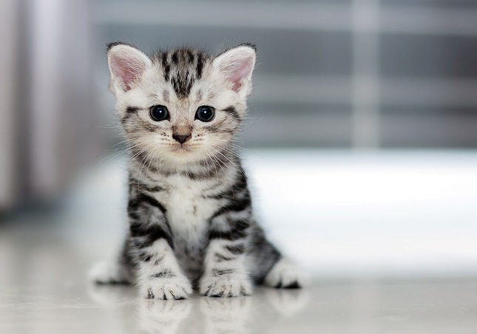
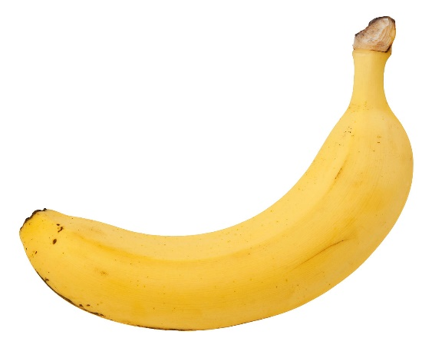
Why we need that?
f( ) = CAT
f( ) = BANANA

Slide 10
How to make machine learn?
The first thing to handle…
-DATA!
-with target values? Regression
-without target values? Clustering
-easy to know the target values? Playing chess

Slide 11
How to make machine learn?
Supervised learning
- Regression
- Pattern recognition
Unsupervised learning
- Clustering
Reinforcement learning
- Alpha go
Combinations

Slide 12
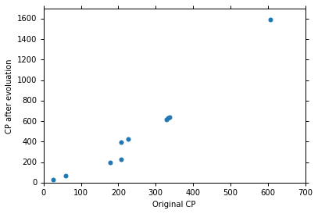
How to make machine learn?

Slide 13
How to make machine learn?
We made a hypothesis!
Hypothesis set → H
Try to find the best line!
- Linear regression

Slide 14

How to make machine learn?
Error $=\sum_{n=1}^{10}{{\left({\hat{y}}^{n}−\left(b+w∙x_{cp}^{n}\right)\right)}^{2}}$

Slide 15
How to make machine learn?
Unknown target function
f : X → Y
Final hypothesis
g ≈ f
Training examples
(x₁,y₁), (x₂,y₂),…, (x_{n},y_{n})
Algorithm
A
Learning from data, page 4
Hypothesis
H

Slide 16
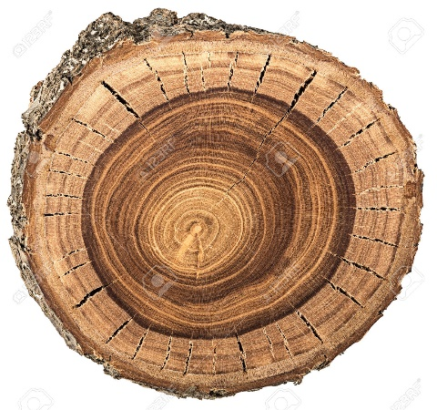
What could we do with ML?
Image recognition
f( ) = CAT
Check the origin of wood by wood circles
- Prof. John Hermanson

Slide 17
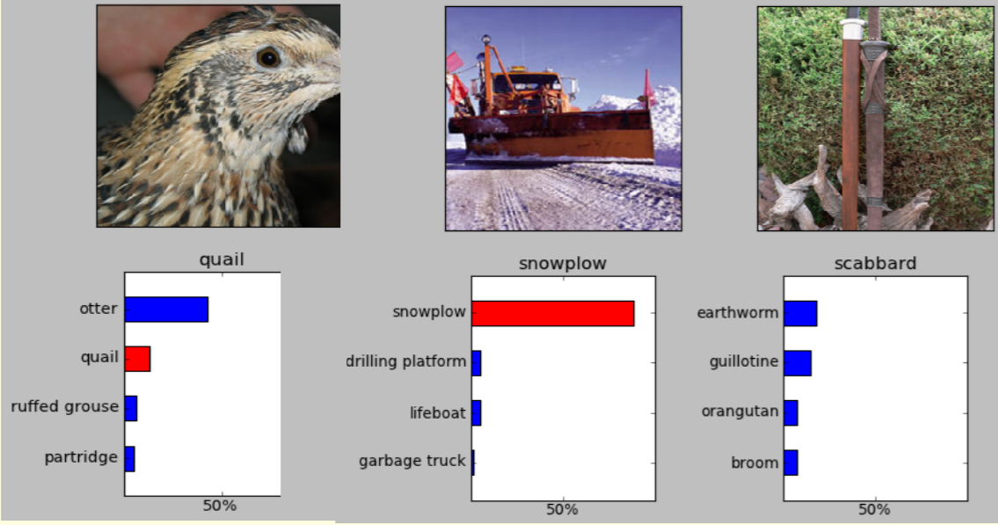
What could we do with ML?
Image recognition Hinton, coursera

Slide 18
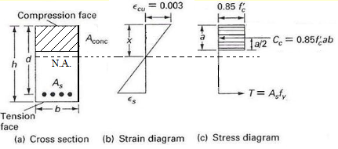
What could we do with ML?
Material science
- Model stress-strain relations
- No need to simplify model

Slide 19
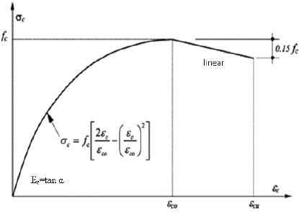
What could we do with ML?
Hognestad (1951)

Slide 20
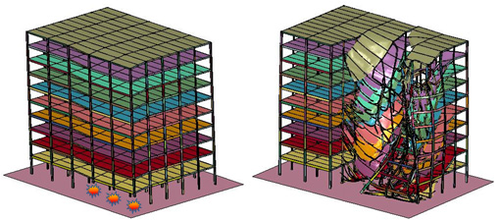
What could we do with ML?
Structural modeling
- Progressive collapse
http://www-personal.umich.edu/~eltawil/progressive-collapse.html

Slide 21
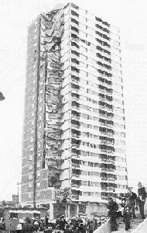
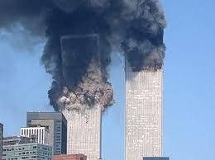
What could we do with ML?
Progressive collapse

Slide 22
What could we do with ML?
Simplified model
- A lot of assumptions!
- Limitations on usage
- Is this correct? Maybe…but philosophically logic

Slide 23
What could we do with ML?
Use finite element software for simulation data
Apply machine learning for more universal models
Unknown target function
f : X → Y
Training examples
(x₁,y₁), (x₂,y₂),…, (x_{n},y_{n})

Slide 24



What could we do with ML?
Also…make some money!
https://www.kaggle.com/
As high as 1 million $$$

Slide 25
What you could learn?
PLA, linear regression, logistic regression…
Generalization
Bayes method
SVM
A lot of other stuff…

Slide 26
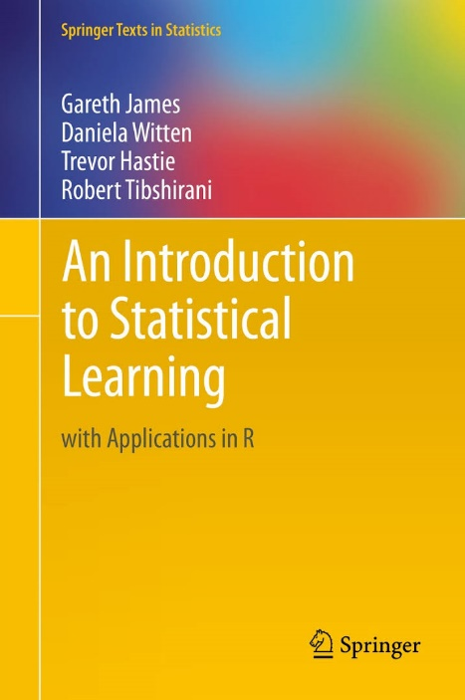
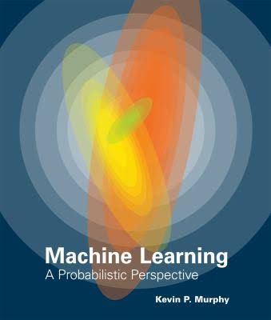
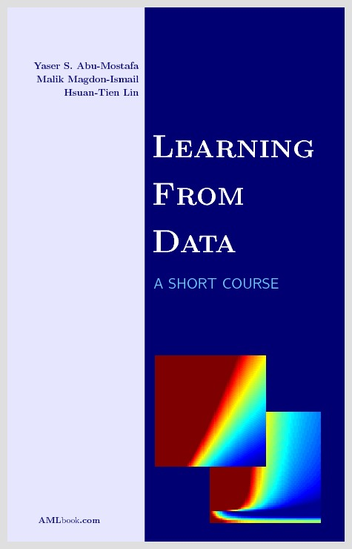
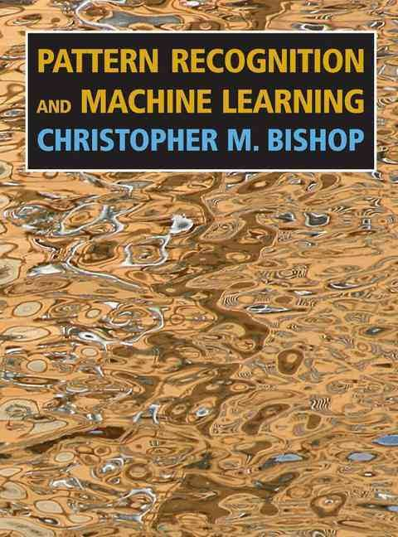
Resources
Online courses: edx, coursera
Stanford public courses…

Slide 27
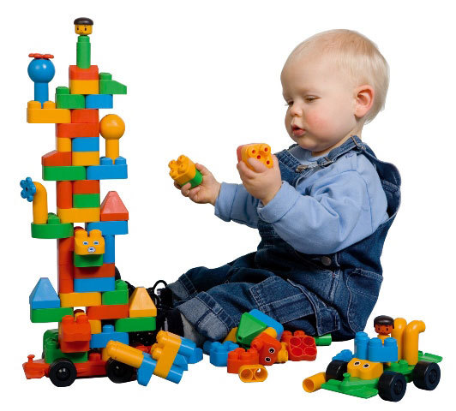
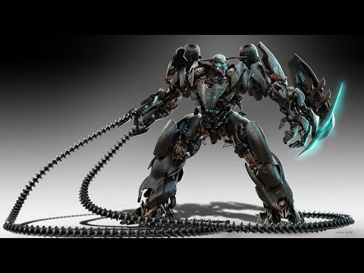
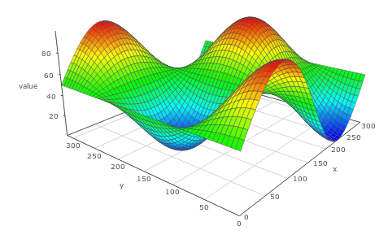
Questions?
You think you are doing…
Your professor think you are doing…
In fact…

